Slide 1

AeroGreen
Enabling Sustainable Skies

Slide 2
Team AeroDev :
Deepak Singh(Leader)
Babitha Kumari
Debasish Biswal
Adithya R Pai
Vanshika Saini

Slide 3
Agenda
Overview
User Interface
Team
Problems to solve
Technical Architecture
Project objective
System Flow diagram
The Solution
Conclusion

Slide 4

Overview
The aviation industry is under pressure to reduce its environmental impact, particularly in terms of greenhouse gas emissions. Recycling and repurposing end-of-life aircraft components is an important area for improvement. However, this process is complex and requires coordination among multiple stakeholders.

Slide 5
Problems to solve
Lack of Coordination: There is often a lack of efficient coordination between aircraft manufacturers, airlines, and recycling facilities, resulting in inefficient or fragmented recycling processes.
Economic Viability: Developing cost-effective and financially viable recycling solutions is essential to encourage the adoption of sustainable practices within the aviation industry.
1
3
2
Resource Efficiency: Many valuable materials and components within retired aircraft are not effectively identified, tracked, and recovered for reuse or recycling, leading to a significant waste of resources.
4
Data Management: There is a need for effective data management systems that track the lifecycle of components, provide traceability, and enable informed decision-making in the recycling and repurposing processes.

Slide 6
Project objective
Create an aircraft sustainability platform connecting manufacturers, airlines, and recycling facilities for collaborative end-of-life component repurposing and recycling. Improve resource utilization, environmental sustainability, compliance, and economic opportunities in aviation. Revolutionize component management.

Slide 7
The Solution:
A that platform enables seamless communication and collaboration among aircraft manufacturers, airlines, and recycling facilities, fostering a cooperative ecosystem for sustainable component management..
Comprehensive reporting and analytics capabilities, offering stakeholders insights into their sustainability efforts, environmental impact, and resource utilization, enabling informed decision-making
Data-driven insights to optimize the utilization of valuable materials and components from retired aircraft, minimizing waste and promoting resource efficiency.

Slide 8



Key Features
Database of aircraft parts that includes information on their material composition, age, and condition etc.
Manufacturers and airlines to buy/identify components that are nearing the end of their useful life and arrange for their repurposing or recycling
Recycling facilities identify sources of recycled materials, including both metals and non-metallic materials such as composites and plastics
Overview of the recycled and repurposed materials through chart
Environmental impact metrics to show the positive impact of recycling and repurposing
Performance metrics to track the success of the circular economy models

Slide 9










Technical Architecture
Front-end
HTML
CSS
JavaScript
Bootstrap
Framework
Django
Database
SQLite

Slide 10
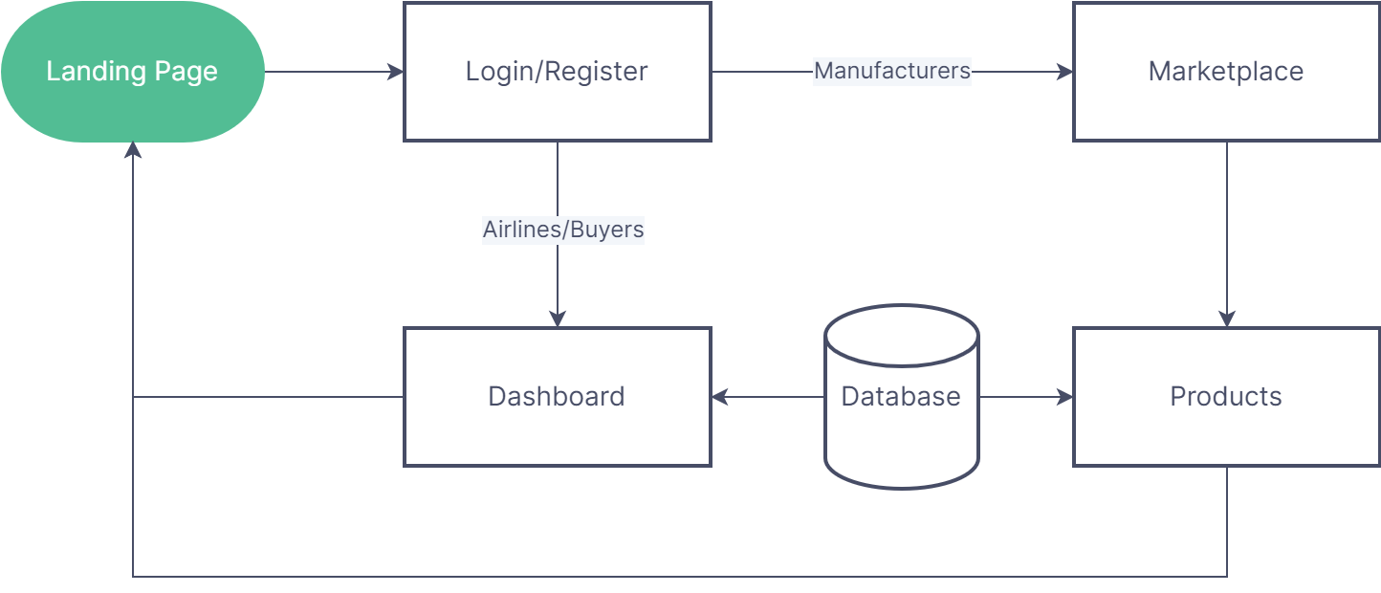
System Flow Diagram

Slide 11
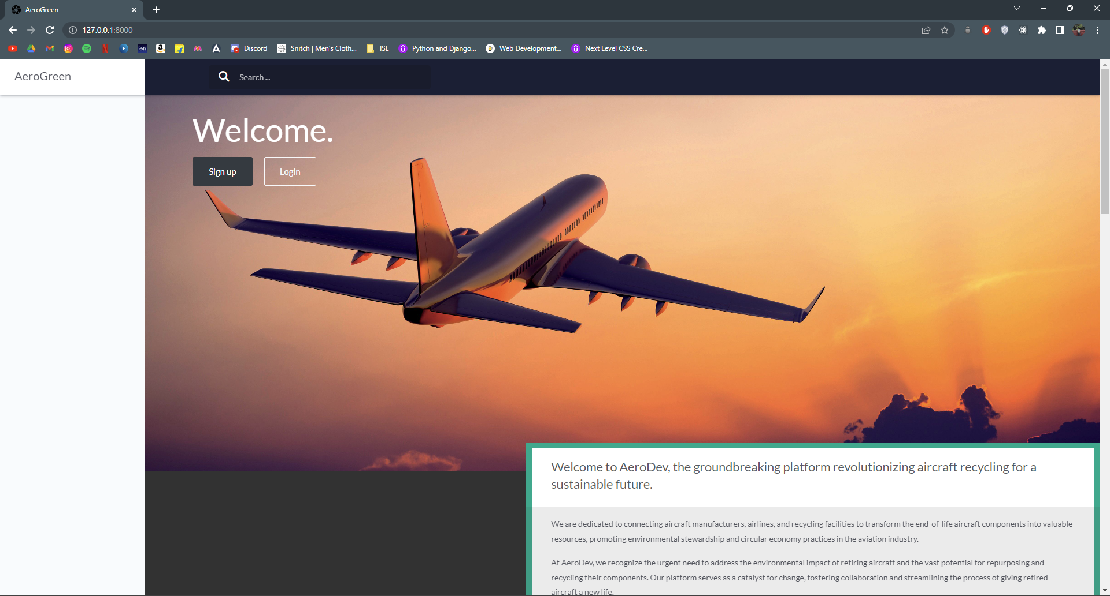
User Interface
Landing Page

Slide 12
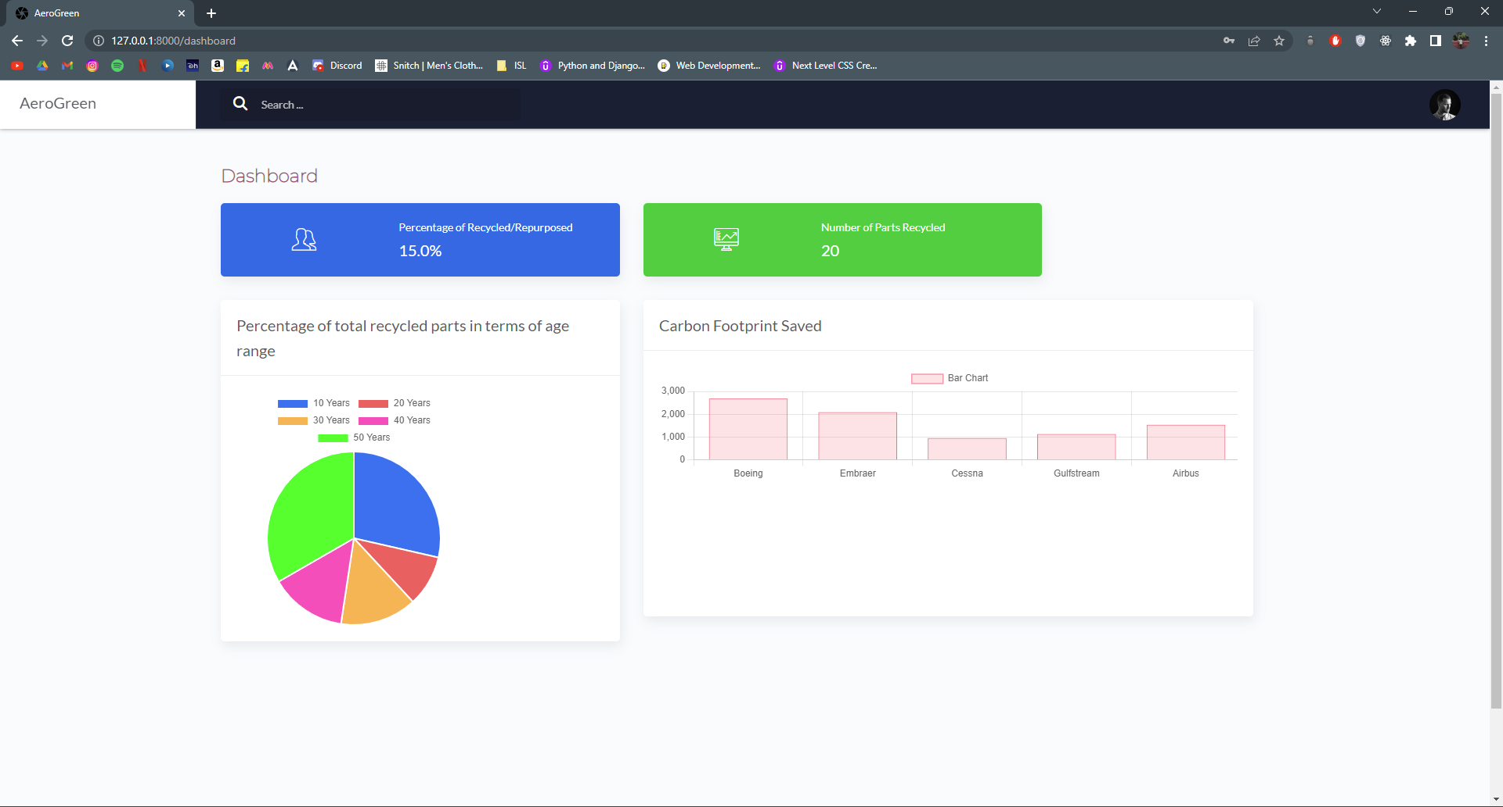
User Interface
Dashboard

Slide 13
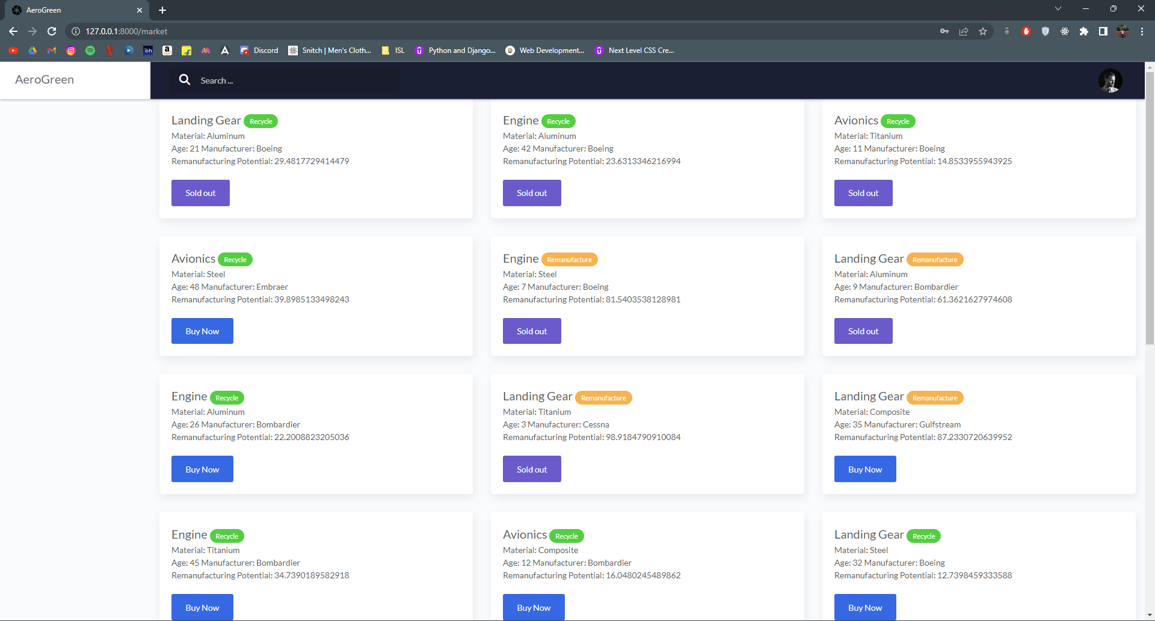
User Interface
Marketplace

Slide 14
Conclusion

Slide 15
The Aircraft Sustainability Platform connects stakeholders, enabling collaborative repurposing and recycling of end-of-life components. The platform revolutionises aircraft sustainability for a greener future by optimising resources, promoting environmental sustainability, maintaining regulatory compliance, and offering commercial opportunities.

Slide 16
Thank you.

